Slide 1



Intelligent Derivations
By: Ashley Guidot, Forrest Surles, Vishwanath Subramanian, and John Weldon

Slide 2
Executive Summary
Calculate optimal combination and weightings of input portfolio while respecting risk tolerance levels.
01
Application will receive user input for risk tolerance, capital, and stocks.
02
Application produces optimal weighting and trading signal based on model time period.
03
Notes:
The objective of this project was to build two models, the first to predict a trading trigger method & the second to optimize client portfolio of stocks.
Stock Signal Model: Uses historical performance to signal stock movements & predicts near term direction. This model also performs back-testing.
• Portfolio Optimizer Model: Given a user’s preferred portfolio of stocks and starting capital, the model optimizes the stock weightings for a specific criteria
• Max Sharpe Ratio (Highest Risk)
• Minimum Volatility (Lowest Risk)
• Efficient Risk (User sets acceptable volatility limit for Portfolio)
The above models have been successfully built using a 15 stock portfolio covering the Tech, Mining and Car industries with the Vanguard 500 Index Fund ETF VOO serving as a alternative (risk reducing investment option & performance benchmark)

Slide 3


Objective
Create practical application to test historic stock data and predict future performance applying lessons learned throughout course

Slide 4

Group Approach
Ashley – create API connections, collect stock data and cleanup, and calculations
John – implement risk tolerance and strategy selection logic
Vishwanath – project management, back-testing framework, and deep learning models
Forrest – develop user stories and documentation
All – visualization, analysis, and presentation

Slide 5
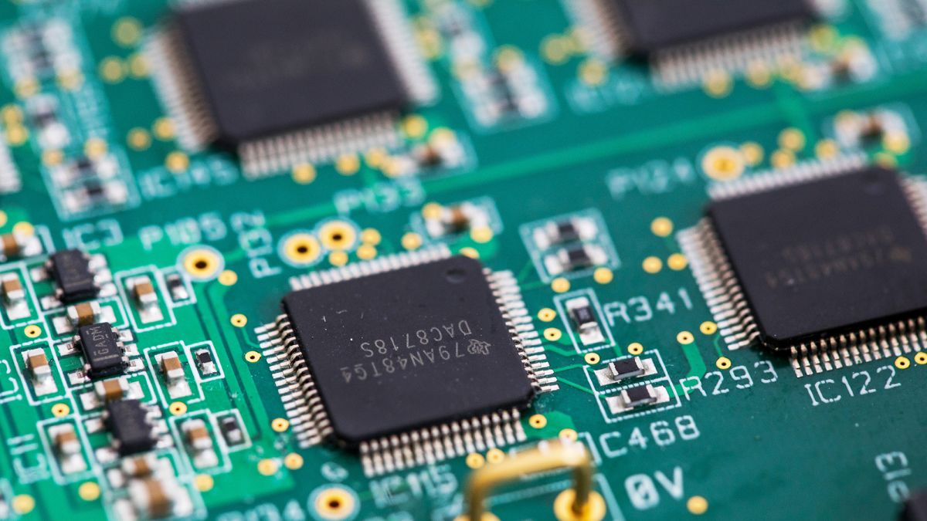
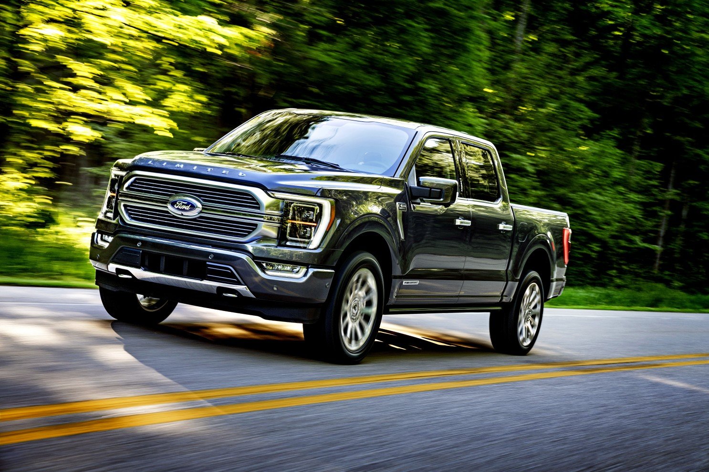

Stocks chosen
AMAT
AMD
BHP
DDD
F
FCX
INTC
MSFT
NVDA
QCOM
RIO
TSLA
TSM
VALE
VOO (control)
Notes:
TSM : Taiwan Semiconductor Manufacturing Company –
QCOM : Qualcomm –
AMAT : Applied Materials –
AMD : Advanced Micro Devices –
NVDA : Nvidia –
DDD : 3D Systems Corp –
FCX : Freeport McMoran –
RIO : Rio Tinto –
TSLA : Tesla –
F : Ford Motor Company –
VALE : Vale –
BHP : BHP –
INTC : Intel Corporation –
MSFT : Microsoft –
VLKAF : Volkswagen
VOO: Vanguard 500 Index Fund ETF as our control

Slide 6
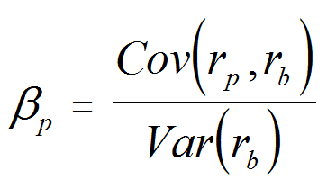

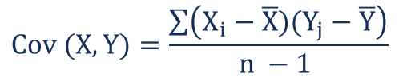
Stock calculations
Pulled data from Alpaca
Merged data due to free limits
Selected VOO as control stock
Calculated:
Covariance
Variance
Betas

Slide 7
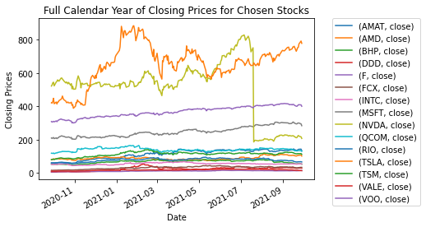
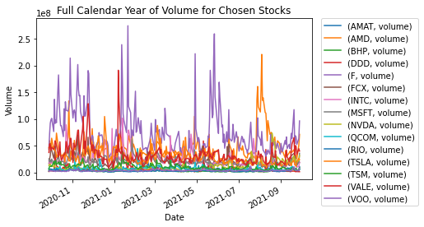
Stock visuals

Slide 8
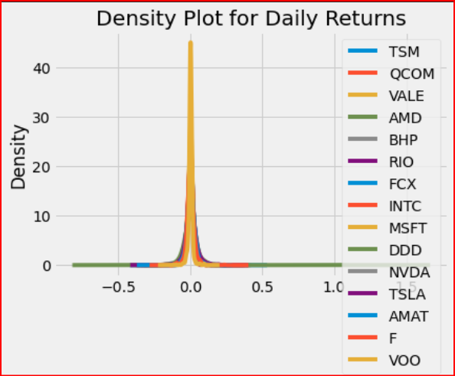
Portfolio Optimization
15 Stocks Evenly Weighted
Measure | Result
Exp. Ann. Return | 49.0%
Annual Volatility | 33.0%
Annual Variance | 11.0%
Focus
Mean-Variance optimization
General Efficient Frontier
Cases
Maximum Sharpe
Minimum Volatility
Efficient Risk Data Prep Highlights:
Set up returns & COV data-frames
Use variance, volatility, and annualized portfolio return to use as a base case

Slide 9
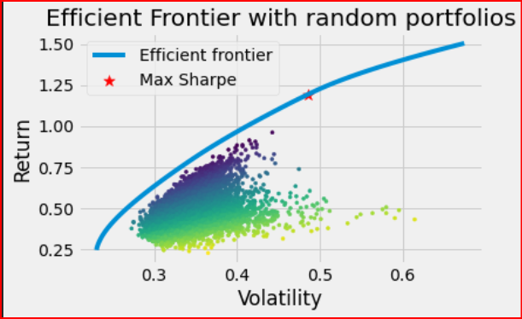
Portfolio Optimization: Max Sharpe
Max. Sharpe Results
Discrete Allocation
Measure | Result
Exp. Ann. Return | 119.3%
Annual Volatility | 48.6%
Sharpe Ratio | 2.42
Initial Portfolio $1M
10,000 Random Portfolios
Randomly assigned weights to stock dataset
Constraints: Sum of weights =1.0
Cleaned Weights: Ensured that stock purchase allotments were in whole numbers
Stock | # Shares
TSM | 265
AMD | 774
NVDA | 1939
TSLA | 635

Slide 10
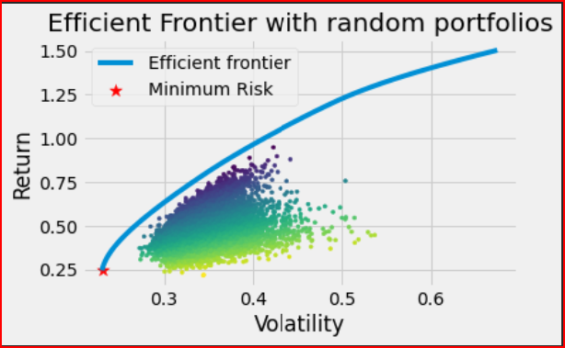
Portfolio Optimization: Min. Volatility
Min. Volatility Results
Measure | Result
Exp. Ann. Return | 24.5%
Annual Volatility | 23.0%
Sharpe Ratio | 0.98
Discrete Allocation
Same set up as first case
Constraints:
Efficient Frontier set to minimum volatility
Sum of weights = 1.0
Observations:
99% of the initial investment was allocated to just one stock (VOO)
Stock | # Shares
TSM | 91
VOO | 2487

Slide 11
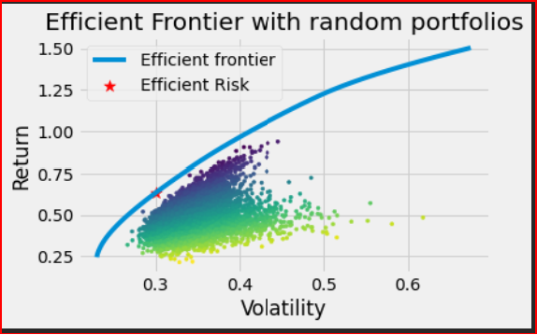
Portfolio Optimization: Efficient Risk
Discrete Allocation
Stock | # Shares
TSM | 1747
AMD | 246
MSFT | 732
NVDA | 208
TSLA | 245
F | 1316
VOO | 804
Efficient Risk Results
Measure | Result
Exp. Ann. Return | 63.4%
Annual Volatility | 30.0%
Sharpe Ratio | 2.05
Constraints:
Sum of weights = 1.0
Max. Allowable Volatility pre-set to 30%

Slide 12

User stories
As an investor, I want to know the most efficient stock weights for my portfolio so that potential profits are maximized
App launch and user begins, then prompted for their risk tolerance, total capital, and list of portfolio candidates
When submitted, then application retrieves historical data of the stock candidates
Notes:
•As an investor, I want to know the most efficient stock weights for my portfolio so that potential profits are maximized.
## Open the application
•Given the first app launch, the user is prompted to begin, then prompted for their risk tolerance, total capital, and list of portfolio candidates.
## User Input
•Given the completed user inputs, when the user selects submit, then the application retrieves historical data of the stock candidates.

Slide 13

Questions?
Thank you for coming to our Ted Talk
Does anyone have any questions?

